Slide 1
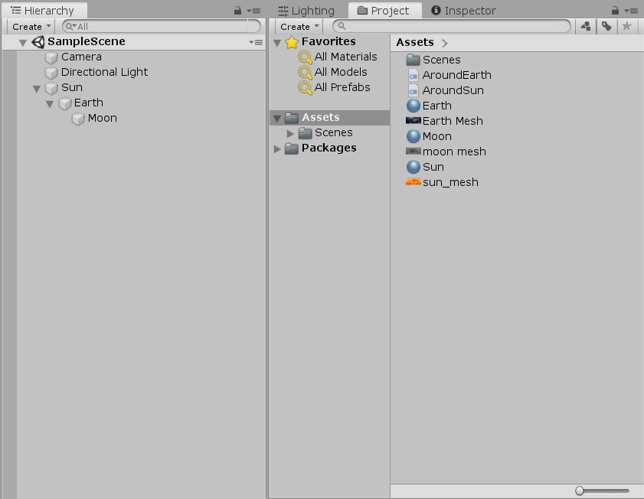
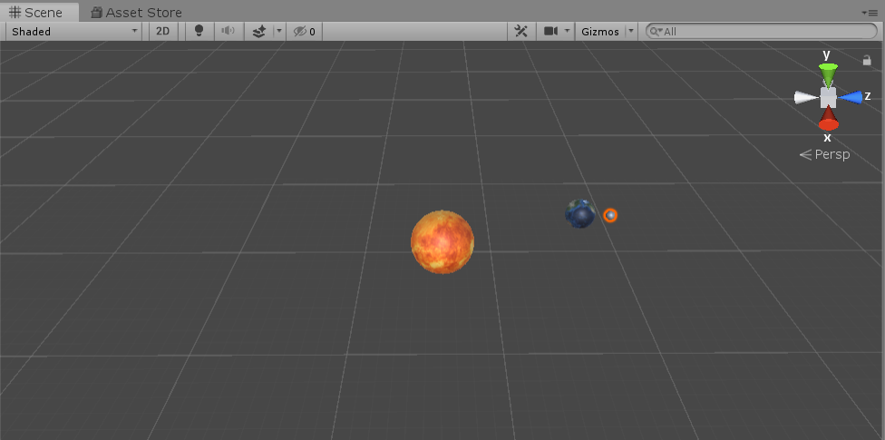
Make moon go around the earth
Make earth go around the sun
Material & Texture

